Slide 1

Customer Shopping Behavior Analysis
Uncovering insights from transactional data to drive strategic business decisions.

Slide 2

Project Overview
Goal
Analyze 3,900 purchases to understand spending, segments, preferences, and subscriptions.
Purpose
Guide strategic business decisions with data-driven insights.

Slide 3

Dataset Summary
Missing Data:
37 values in Review Rating column
Rows: 3,900Columns: 18
Key Features:
Customer demographics (Age, Gender, Location, Subscription)
Purchase details (Item, Category, Amount, Season, Size, Color)
Shopping behavior (Discount, Promo, Previous Purchases, Frequency, Review, Shipping)

Slide 4
Exploratory Data Analysis (Python)
01
02
03
Data Loading & Exploration
Missing Data Handling
Column Standardization
Imported dataset, checked structure and summary statistics.
Imputed missing 'Review Rating' using median per category.
Renamed columns to snake_case for readability.
04
05
Feature Engineering
Database Integration
Created 'age_group' and 'purchase_frequency_days'.
Loaded cleaned data into PostgreSQL for SQL analysis.

Slide 5


Data Analysis (SQL Insights)
Revenue by Gender
Top 5 Products by Rating
Male: $157,890
Female: $75,191
Gloves (3.86), Sandals (3.84), Boots (3.82), Hat (3.80), Skirt (3.78)
Shipping Type Comparison
Standard: $58.46
Express: $60.48

Slide 6
Subscription & Discount Insights
Subscribers vs. Non-Subscribers
Discount-Dependent Products
Yes
1053
$59.49
$62,645
Hat
50.00%
No
2847
$59.87
$170,436
Sneakers
49.66%
Coat
49.07%
Sweater
48.17%
Pants
47.37%

Slide 7



Customer Segmentation
New
1
83 Customers
Returning
2
701 Customers
Loyal
3
3116 Customers

Slide 8

Top Products by Category
Accessories
Clothing
Footwear
Jewelry (171 orders)
Blouse (171 orders)
Sandals (160 orders)
Sunglasses (161 orders)
Pants (171 orders)
Shoes (150 orders)
Belt (161 orders)
Shirt (169 orders)
Sneakers (145 orders)

Slide 9

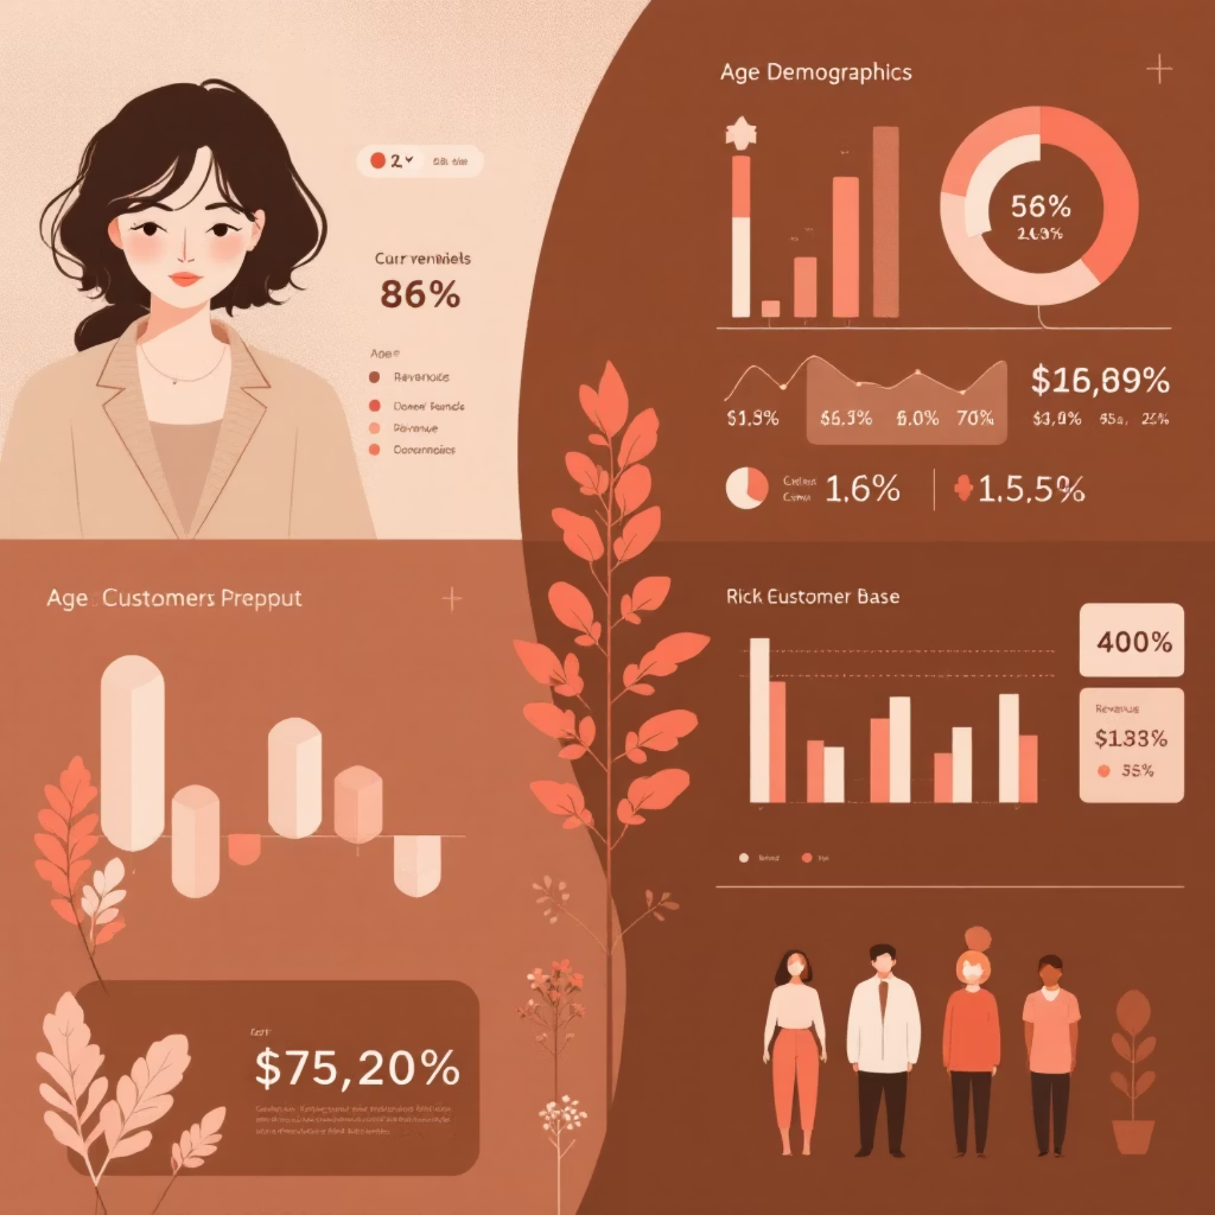
Repeat Buyers & Age Group Revenue
Repeat Buyers & Subscriptions
Revenue by Age Group
Customers with >5 purchases:
Young Adult: $62,143
No Subscription: 2518
Middle-aged: $59,197
Yes Subscription: 958
Adult: $55,978
Senior: $55,763

Slide 10
Business Recommendations
Boost Subscriptions
Promote exclusive benefits.
Customer Loyalty
Reward repeat buyers.
Review Discount Policy
Balance sales with margin.
Product Positioning
Highlight top-rated items.
Targeted Marketing
Focus on high-revenue groups.

